Slide 1

Netflix Stock Profile of 2017
Codecademy Data Visualization Project

Slide 2
List of Visualizations
Comparing the Netflix quarterly data through distribution.
Looking at the projected earnings compared to the actual earnings for each quarter.
The earnings and revenue from Netflix for each quarter.
Compare the Netflix and the Dow Jones stock prices for 2017.

Slide 3
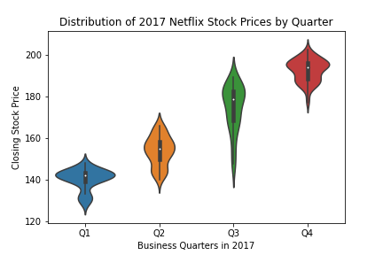
Distribution of Netflix Stock by Quarter
Based on each quarter, we can see that the closing stock prices went from around $125 in Q1, to about $205 in Q4.
In Q1, the stock price stayed around $140 to $145; but would occasionally drop down to about $135 or jump up to $150. There were a lot of outliers (rare occurrences) below the $135 range, and very few above $150.
In Q2, the stock stayed around $150 to $160; but would occasionally drop down to around $140 or jump up to $170. The stock has very few outliers below $140 or above $170; but the range of the stock starts to become greater compared to Q1.
In Q3, the stock stayed around $170 to $180; but would occasionally drop down to $150 or jump up to $190. The stock has very few outliers below $150, but more outliers above $190. The range of the stock has become even greater than Q2.
In Q4, the stock stayed around $190 to $195; but would occasionally drop down to $180 or jump up to around $205. The stock has very few outliers below $180, but more outliers above $205. The range of the stock has become very similar to the range of Q1, but at a higher price point.
We could suggest that Q1, and Q4 are the safest times to buy or sell the stock as the price doesn’t very much. Q2 starts to become more volatile, but still relatively safe. Q3 is the most volatile, making it riskier to buy and sell the stock during this quarter; however, will be the best time to make more money off the stock.

Slide 4
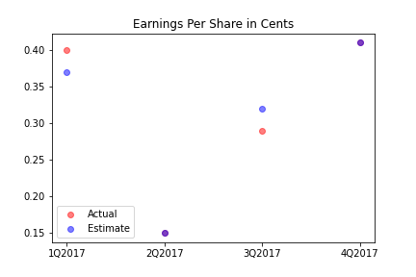
Earnings Per Share for Netflix stock in 2017
Earnings per share (EPS) is a ratio that gauges how profitable a company is per share of its stock (Nickolas & Rhinehart, 2021).
In Q1, the actual EPS was a couple cents more at $0.40, than the estimate at about $0.37. This means that the company gained an extra $0.03 per stock than anticipated.
In Q2, the actual EPS and the estimated one were the same at $0.15 per share, meaning the company didn’t gain or lose any extra money than anticipated.
In Q3, the actual EPS was a couple cents less at about $0.28 than the estimate at about $0.32. This means that the company lost about $0.04 per stock than anticipated.
In Q4, the actual EPS and the estimated EPS were the same at about $0.41 per share, meaning the company didn’t gain or lose any extra money than anticipated.
Based on the graph we can assume that the extra gain in money in Q1, and the loss of money in Q4 ends up canceling out & the actual amount of earnings per share is equal to the estimated earnings per share.
Nickolas, S. (2021, April 30). Earnings Per Share (EPS) vs. Dividends Per Share (DPS): What's the Difference? Investopedia. Retrieved February 18, 2022, from https://www.investopedia.com/ask/answers/032515/what-difference-between-earnings-share-and-dividends-share.asp#:~:text=Earnings%20per%20share%20is%20a,a%20company's%20profitability%20and%20outlook

Slide 5
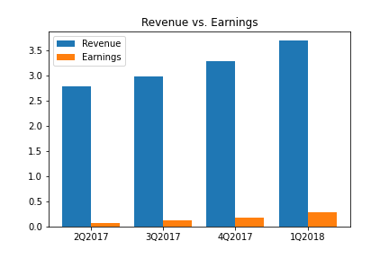
Revenue Compared to Earnings for Netflix in 2017 - 2018
Revenue (also known as Gross Sales) is the total amount of money earned by a company for selling its goods and services. It’s also the income generated before expenses are deducted.
Earnings represents the profit a company has earned; it is calculated by subtracting expenses, interest, and taxes from revenue (Tarver, 2020).
In Q2 of 2017, Netflix made about $2.7 billion on their sales, but after expenses, taxes, etc. (about $2.6 billion), the actual money they made (earnings) was about $100 million.
In Q3 of 2017, Netflix’s revenue was around $3 billion, but after expenses (about $2.9 billion), their earnings were around $200 million.
In Q4 of 2017, Netflix made about $3.3 billion in sales, but only made about $300 million after expenses (about $3.2 billion).
In Q1 of 2018, Netflix’s revenue was about $3.7 billion, but only made around $400 million after expenses (around $3.6 billion).
Based on the graph, we can see that both the revenue and earnings are considered sequential because both graphs keep going up. The revenue is estimated to go up about every $0.5 billion ($500 million) each quarter, the expenses are estimated to also go up about every $0.3 billion ($300 million), and the earnings are expected to go up about $0.1 billion ($100 million). Although Netflix’s revenue is doing very well, their expenses are also going up nearly as high, making their earnings a lot smaller.
Money in Billions
Tarver, E. (2020, June 2). How Do Earnings and Revenue Differ? Investopedia. Retrieved February 18, 2022, from https://www.investopedia.com/ask/answers/070715/what-difference-between-earnings-and-revenue.asp

Slide 6
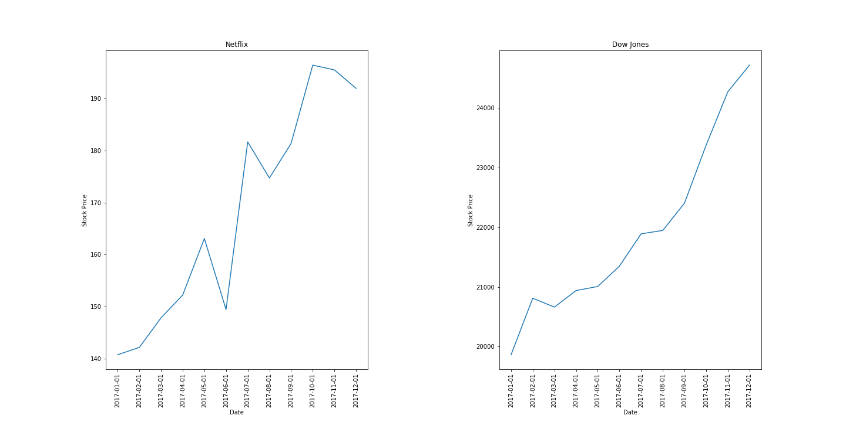
Netflix vs. Dow Jones Stock Price in 2017
The dates for both the Netflix and Dow Jones stocks occurred the first of every month in 2017 from January to December.
The Netflix stock prices are considerably lower starting at $140 a stock to about $200; while Dow Jones stocks start at about $20,000 to $25,000 a stock.
The upward trend of the Netflix and Dow Jones stocks are pretty similar throughout the year; however, Netflix is a lot more volatile because of the drops and peaks throughout the trend. Dow Jones is a lot safer compared to Netflix because of the slow upward trend with very minimal drops.

